Slide 1
Module V

Slide 2
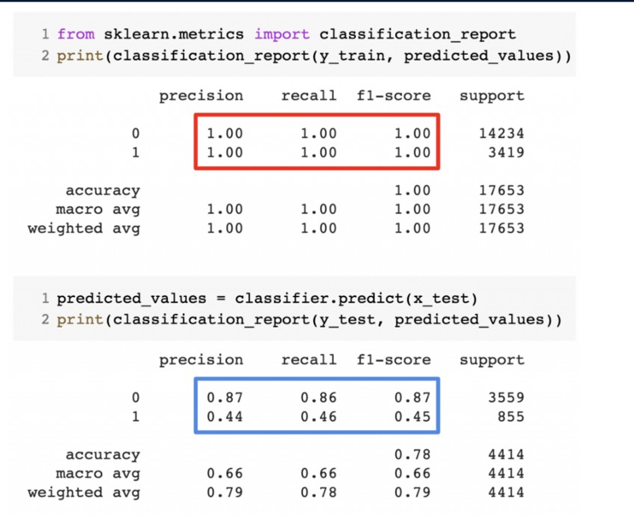

Slide 3


Slide 4
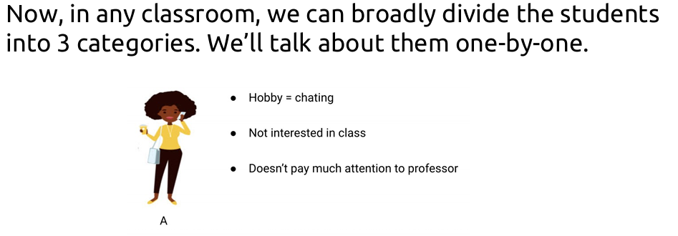
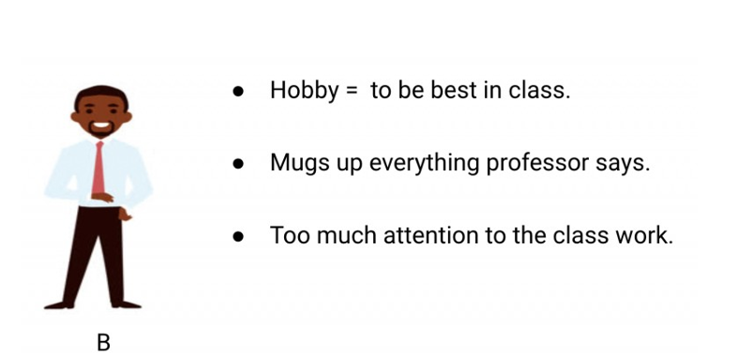

Slide 5
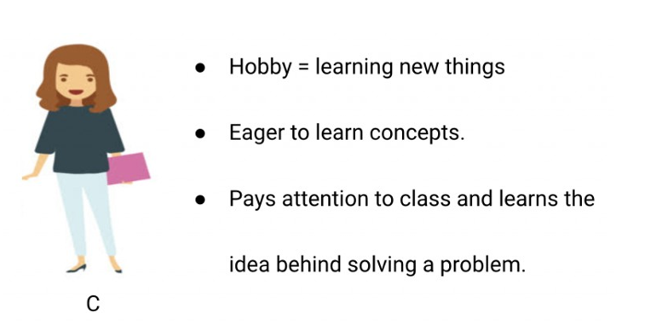

Slide 6



Slide 7
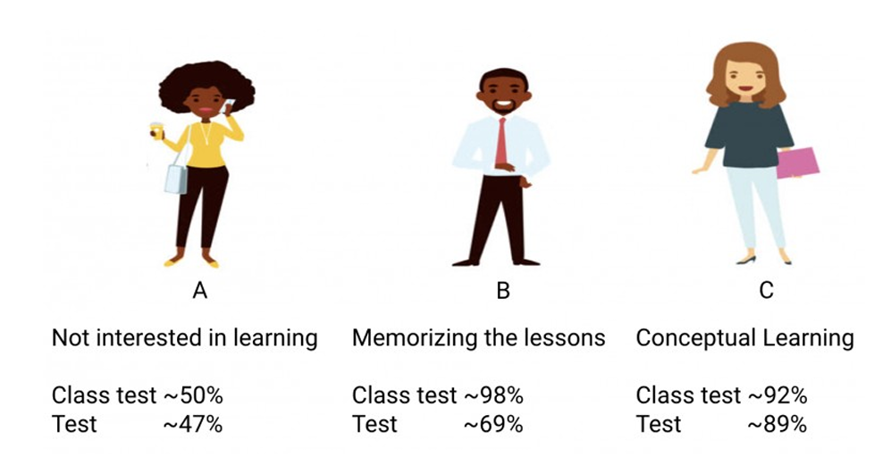

Slide 8
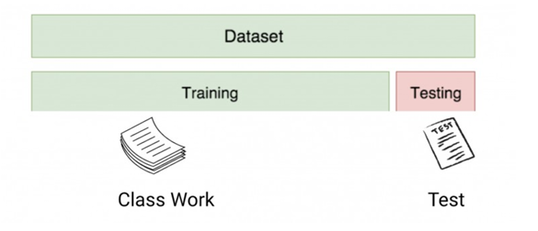
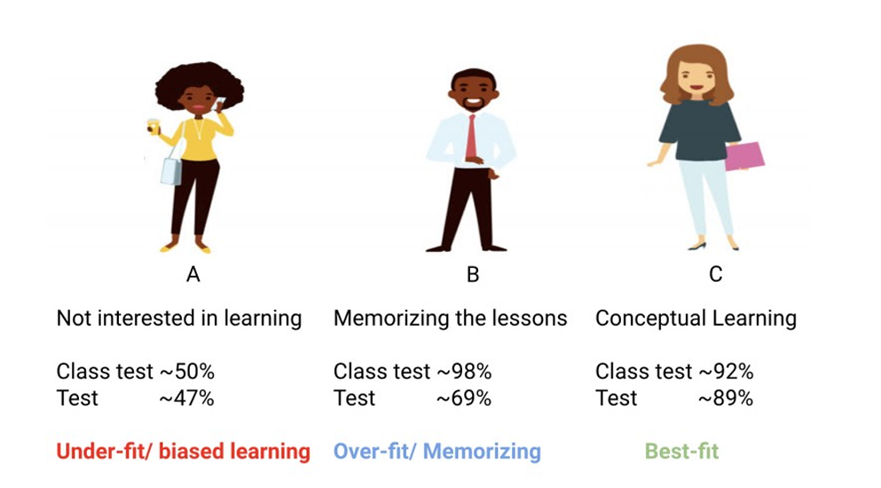

Slide 9
Generalization
Components of generalization error
Bias: how much the average model over all training sets differ from the true model?
Error due to inaccurate assumptions/simplifications made by the model
Imagine using a simple linear model to predict house prices based solely on square footage. If the actual prices also depend on location, age of the house, and number of rooms, the model’s assumptions are too narrow, resulting in high bias.
Variance: how much models estimated from different training sets differ from each other
Underfitting: model is too “simple” to represent all the relevant class characteristics
High bias and low variance
High training error and high test error
Overfitting: model is too “complex” and fits irrelevant characteristics (noise) in the data
Low bias and high variance
Low training error and high test error
Slide credit: L. Lazebnik

Slide 10
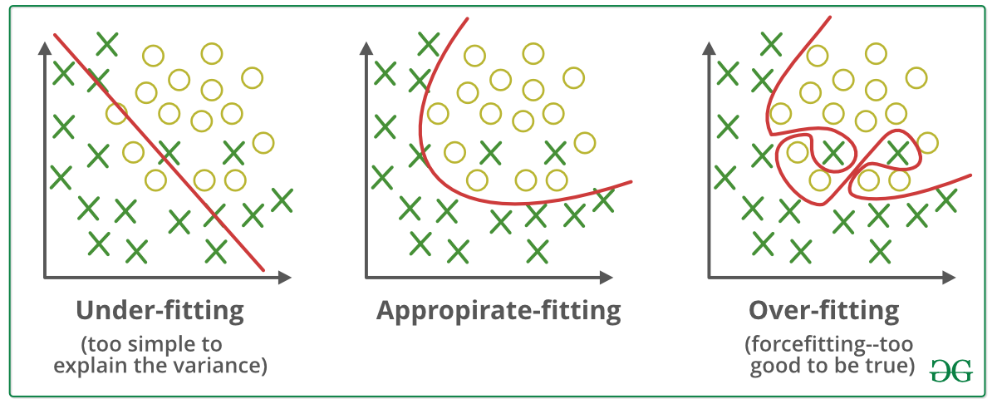
Bias-Variance Trade-off
E(MSE) = noise² + bias² + variance
Error due to variance of training samples
Unavoidable error
Error due to incorrect assumptions
Image credit: geeksforgeeks.com
Slide credit: D. Hoiem
Notes:
From the link above:
You can only get generalization through assumptions.
Thus in order to minimize the MSE, we need to minimize both
the bias and the variance. However, this is not trivial to do this. For instance, just
neglecting the input data and predicting the output somehow (e.g., just a constant), would definitely minimize the variance of our predictions: they would be
always the same, thus the variance would be zero—but the bias of our estimate
(i.e., the amount we are off the real function) would be tremendously large. On
the other hand, the neural network could perfectly interpolate the training data,
i.e., it predict y=t for every data point. This will make the bias term vanish entirely, since the E(y)=f (insert this above into the squared bias term to verify this),
but the variance term will become equal to the variance of the noise, which may
be significant (see also Bishop Chapter 9 and the Geman et al. Paper). In general,
finding an optimal bias-variance tradeoff is hard, but acceptable solutions can be
found, e.g., by means of cross validation or regularization.

Slide 11
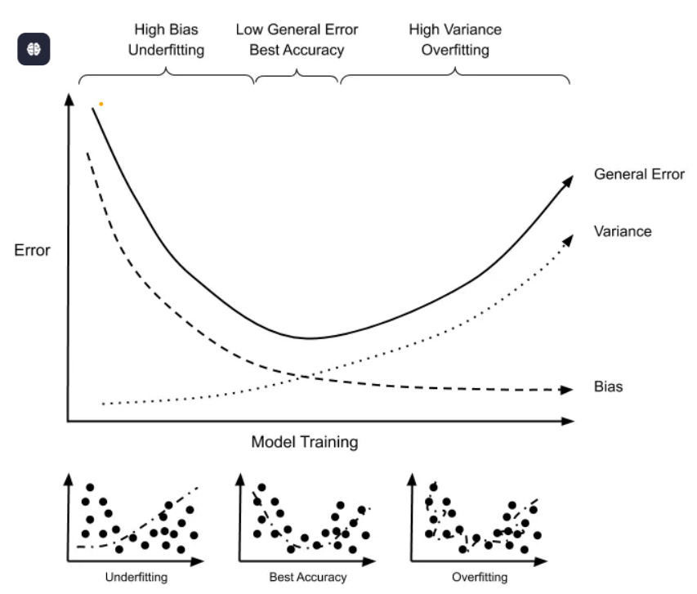
Bias-Variance Trade-off
Image credit: geeksforgeeks.com
Slide credit: D. Hoiem
Notes:
From the link above:
You can only get generalization through assumptions.
Thus in order to minimize the MSE, we need to minimize both
the bias and the variance. However, this is not trivial to do this. For instance, just
neglecting the input data and predicting the output somehow (e.g., just a constant), would definitely minimize the variance of our predictions: they would be
always the same, thus the variance would be zero—but the bias of our estimate
(i.e., the amount we are off the real function) would be tremendously large. On
the other hand, the neural network could perfectly interpolate the training data,
i.e., it predict y=t for every data point. This will make the bias term vanish entirely, since the E(y)=f (insert this above into the squared bias term to verify this),
but the variance term will become equal to the variance of the noise, which may
be significant (see also Bishop Chapter 9 and the Geman et al. Paper). In general,
finding an optimal bias-variance tradeoff is hard, but acceptable solutions can be
found, e.g., by means of cross validation or regularization.

Slide 12
Bias-variance tradeoff
Underfitting
Overfitting
Error
Test error
Training error
High Bias
Low Variance
Complexity
Low Bias
High Variance
Slide credit: D. Hoiem

Slide 13
Bias-variance tradeoff
Few training examples
Test Error
Many training examples
High Bias
Low Variance
Complexity
Low Bias
High Variance
Slide credit: D. Hoiem
Notes:
Note: these figures don’t work in pdf

Slide 14
Effect of Training Size
Fixed prediction model
Error
Testing
Generalization Error
Training
Number of Training Examples
Slide credit: D. Hoiem

Slide 15
How to reduce variance?
Choose a simpler classifier
Cross-validate the parameters
Get more training data
Regularization
Slide credit: D. Hoiem
Notes:
The simpler classifier or regularization could increase bias and lead to more error.

Slide 16
Cross validation
Cross-validation is a statistical method used to estimate the performance (or accuracy) of predictive statistical models.
It is used to protect against overfitting in a predictive model, particularly in a case where the amount of data may be limited.
In cross-validation, you make a fixed number of folds (or partitions) of the data, run the analysis on each fold, and then average the overall error estimate.

Slide 17
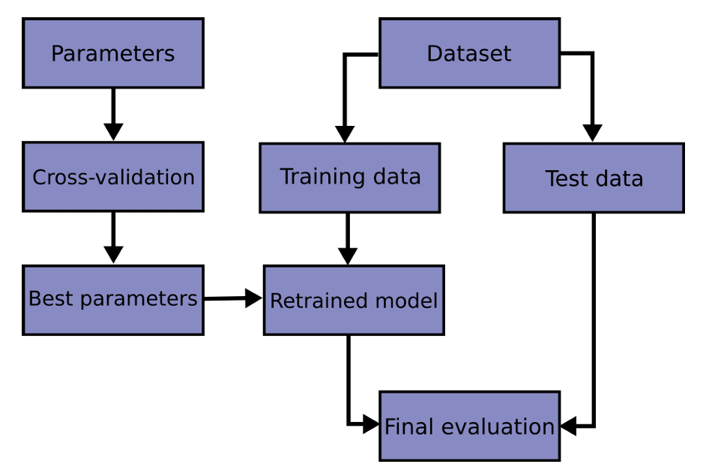

Slide 18
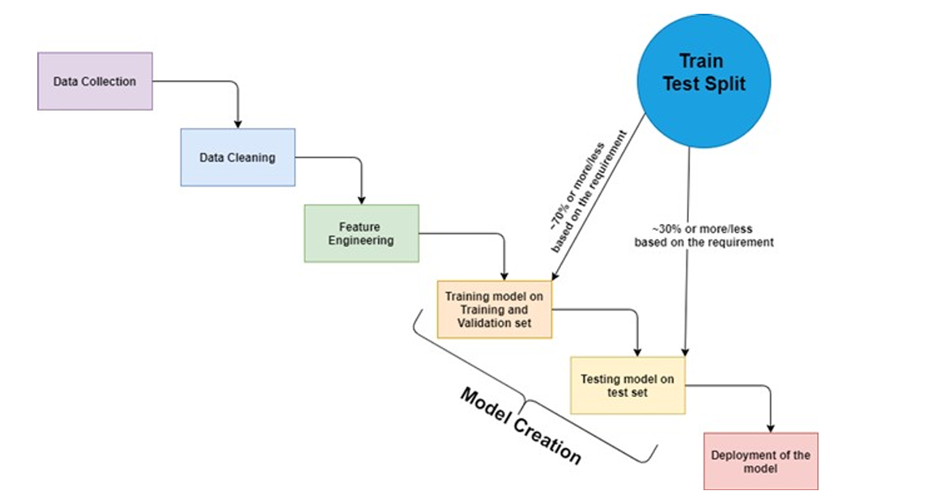

Slide 19
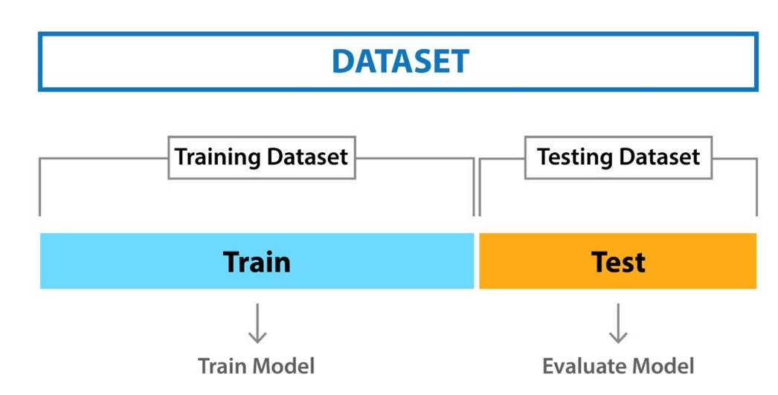
Holdout Method
Basic and simple approach in which we divide our entire dataset into two parts viz- training data and testing data.
As the name, we train the model on training data and then evaluate on the testing set.
Usually, the size of training data is set more than twice that of testing data, so the data is split in the ratio of 70:30, 75:25 or 80:20

Slide 20
Hold Out Method
In this approach, the data is first shuffled randomly before splitting.
As the model is trained on a different combination of data points, the model can give different results every time we train it, and this can be a cause of instability.
Never assure that the train set we picked is representative of the whole dataset.
Hold-out method is good to use when you have a very large dataset

Slide 21
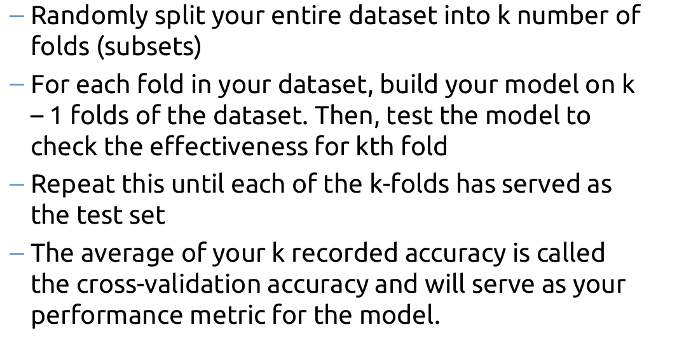
K-Fold Cross Validation
K-fold cross validation is one way to improve the holdout method
Guarantees that the score of our model does not depend on the way we picked the train and test set.
Data set is divided into k number of subsets and the holdout method is repeated k number of times.

Slide 22
